Slide 1
Disclaimer
These slides are intended as presentation aids for the lecture. They contain information that would otherwise be to difficult or time-consuming to reproduce on the board. But they are incomplete, not self-explanatory, and are not always used in the order they appear in this presentation. As a result, these slides should not be used as a script for this course. I recommend you take notes during class, maybe on the slides themselves. It has been shown that taking notes improves learning success.

Slide 2
Reading for this set of slides
Craig – Intro to Robotics (3rd Edition)
1 Introduction
2 Spatial descriptions and transformations (2.1 – 2.9)
3 Manipulator kinematics (3.1 – 3.6)
7 Trajectory generation
Please note that this set of slides is intended as support for the lecture, not as a
stand-alone script. If you want to study for this course, please use these slides
in conjunction with the indicated chapters in the text books. The textbooks are
available online or in the TUB library (many copies that can be checked out for the entire semester. There are also some aspects of the lectures that will not be
covered in the text books but can still be part of the homework or exam. For those
It is important that you attend class or ask somebody about what was covered in class.

Slide 3
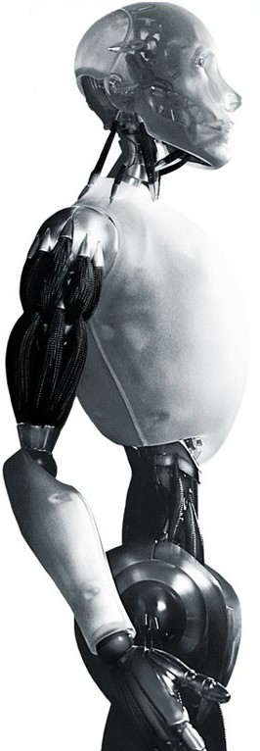
Robotics Achieving Critical Dampening
TU Berlin
Oliver Brock
TexPoint fonts used in EMF.
Read the TexPoint manual before you delete this box.: AAAAAAAAAAAAA

Slide 4







Solving the Equation of Motion (EOM) of a Second Order Linear System
Find trajectory depending on parameters
such that the following holds at all times:
We assume
Therefore
Solve for (easy), then
Notes:
The characteristic equation can only be formed when the differential equation is linear, homogeneous, and has constant coefficients.

Slide 5
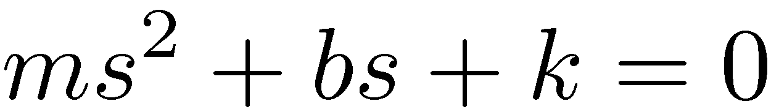
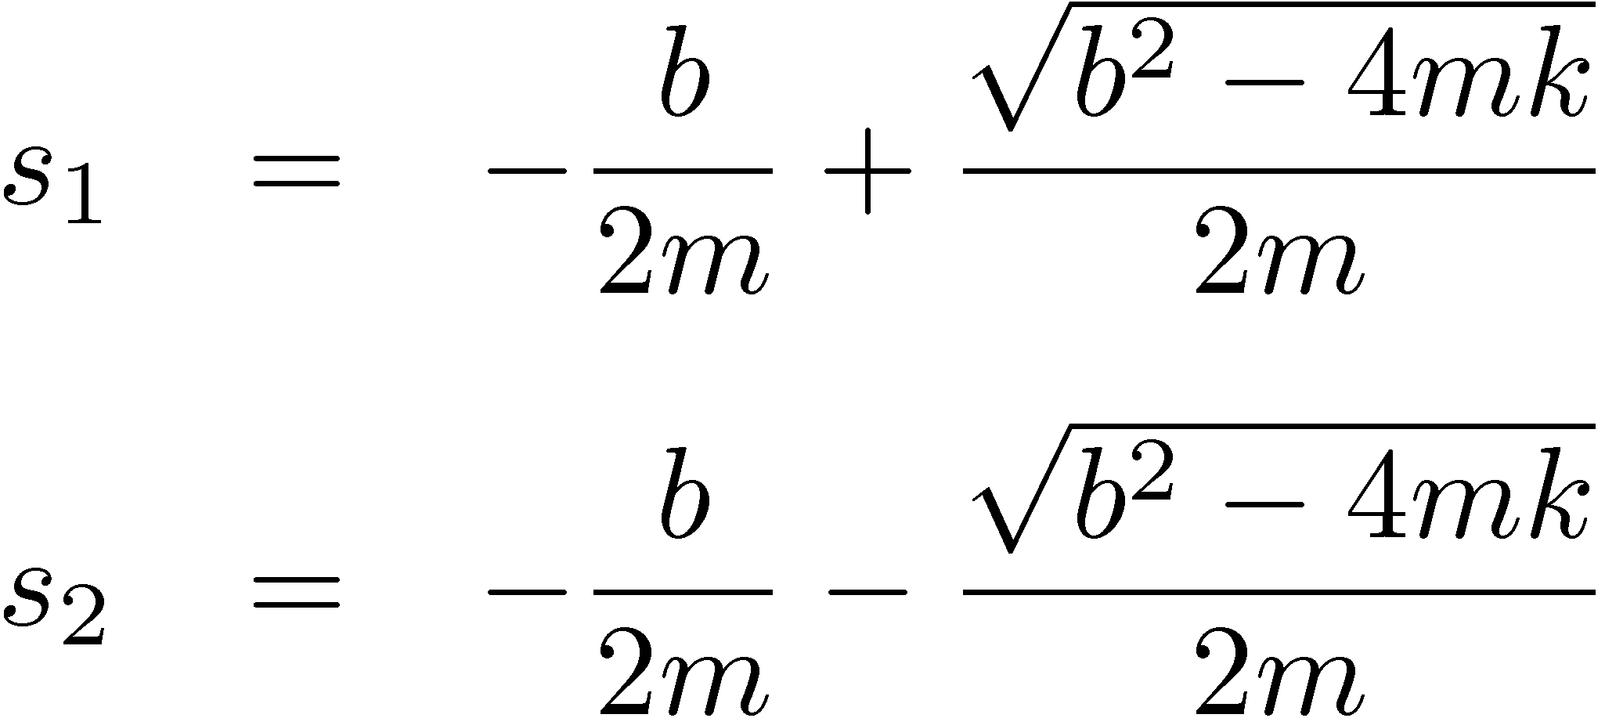
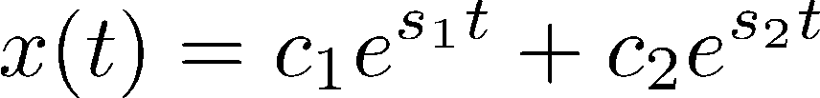
Solving the Equation of Motion (EOM) of a Second Order Linear System
Solutions:
Characteristic equation:
b² > 4mk real and unequal roots overdamped
b² < 4mk complex roots underdamped
b² = 4mk real and equal roots critically damped
Roots (poles):
Solution:
Notes:
The characteristic equation can only be formed when the differential equation is linear, homogeneous, and has constant coefficients.

Slide 6
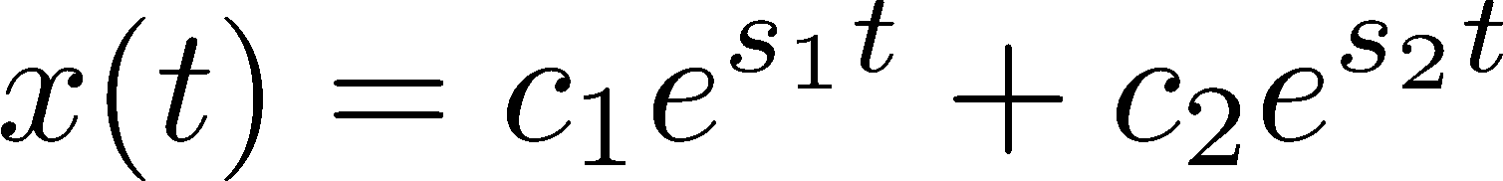
Solution with real, unequal roots (case 1) (overdamped)

Slide 7



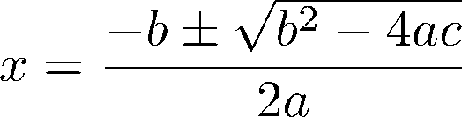










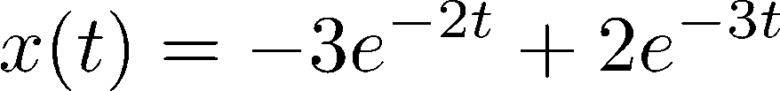

Example (real, unequal roots, case 1)
Notes:
Plot this:
http://www.wolframalpha.com/input/?i=plot+-3exp%28-2t%29+%2B+2exp%28-3t%29+from+t%3D0+to+5+from+y+%3D+-1+to+0
Why does it look critically damped?
Because 4mk is almost equal to b^2

Slide 8
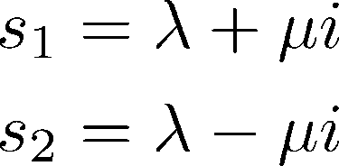


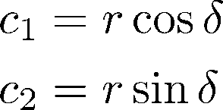

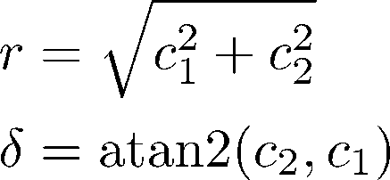
Solution with complex roots (case 2) (underdamped)
Euler’s formula:
with
becomes
where

Slide 9


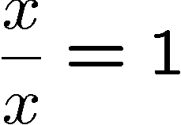


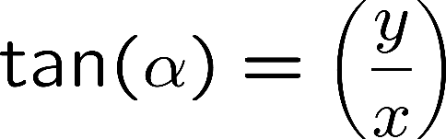
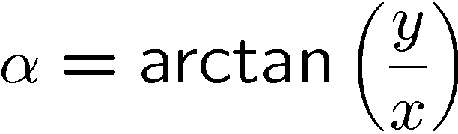
tangent and arctangent
unit circle

Slide 10
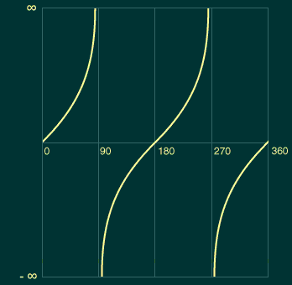
tangent

Slide 11
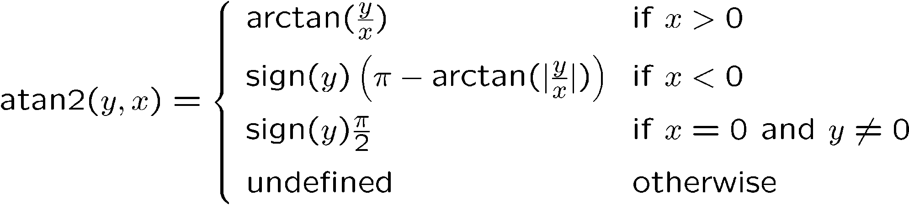
atan2(y,x)

Slide 12
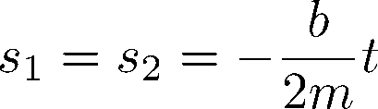

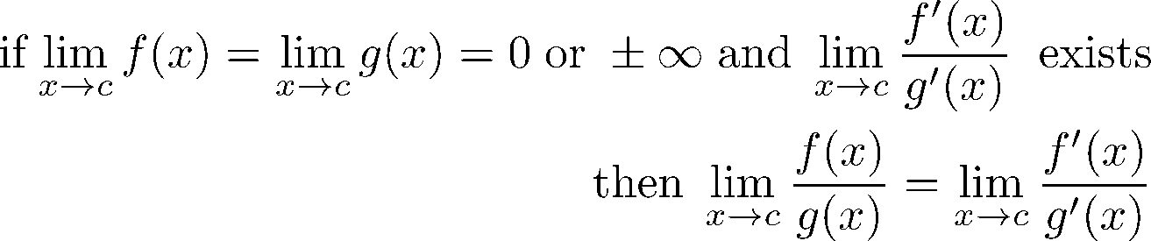
Solution with real, repeated roots (case 3) (critically damped)
Solution:
with:
L’Hôpital’s rule:

Slide 13
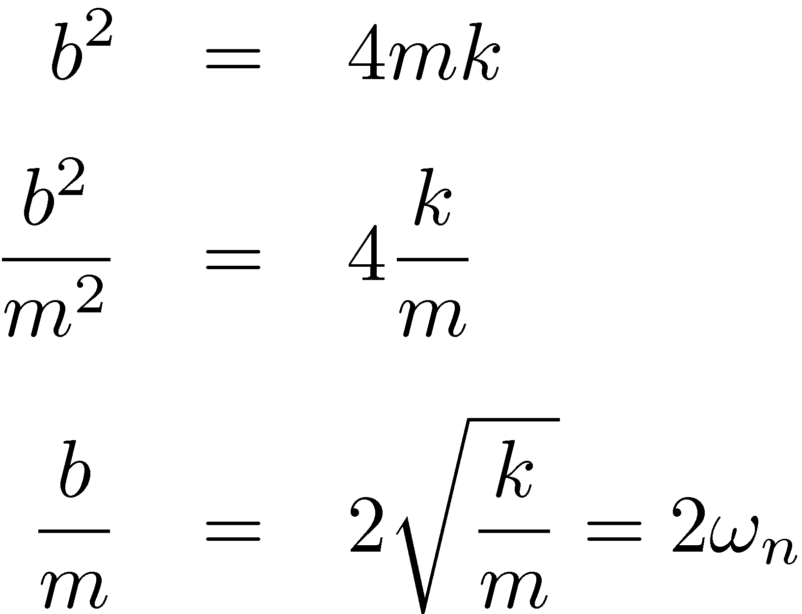
Solving the Equation of Motion (EOM) of a Second Order Linear System
Solutions:
Characteristic equation:
b² > 4mk real and unequal roots overdamped
b² < 4mk complex roots underdamped
b² = 4mk real and equal roots critically damped
Roots (poles):
Solution for cases 1 & 2:
Notes:
The characteristic equation can only be formed when the differential equation is linear, homogeneous, and has constant coefficients.

Slide 14
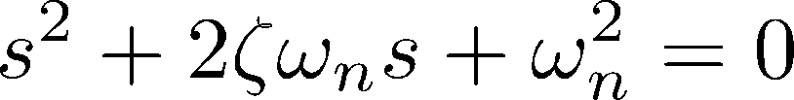
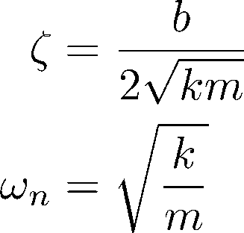
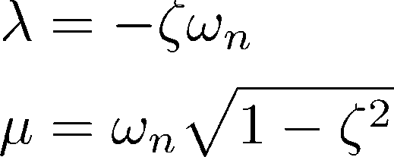
Damping Ratio & Natural Frequency
Original characteristic equation:
Alternative characteristic equation:
damping ratio
with:
natural frequency
Relationship to λ and μ from first characteristic eqn.:
damped natural frequency
Notes:
An alternative to the poles for describing a second order linear system
zeta

Slide 15
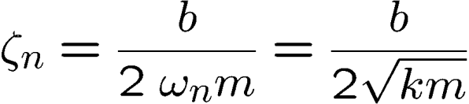
Values of ζ
ζ > 1 : over-damped
ζ = 1 : critically damped
ζ < 1 : under-damped
x
t
Oscillatory-damped
x
Over-damped
t
x
Critically damped
t

Slide 16
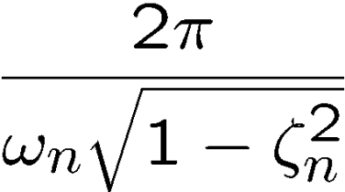

Damped Natural Frequency ω
x
t
Damped Natural Frequency:

Slide 17
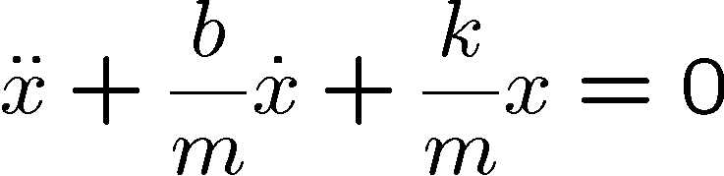
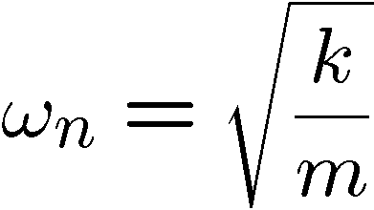
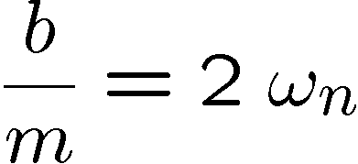
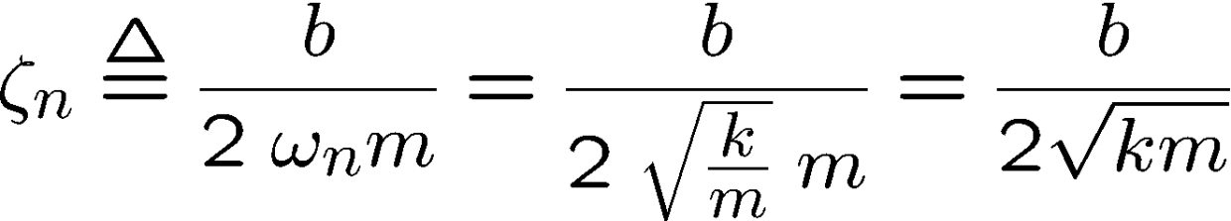

Natural Dampening Ratio
Natural dampening ratio

Slide 18
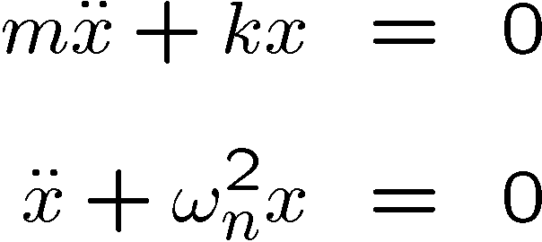
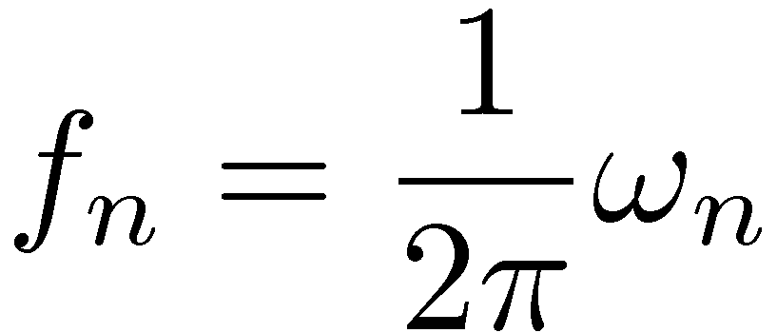
Natural Frequency
x
t

Slide 19
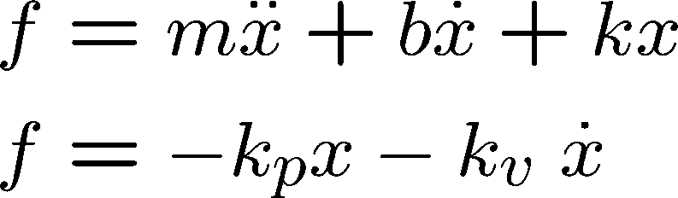
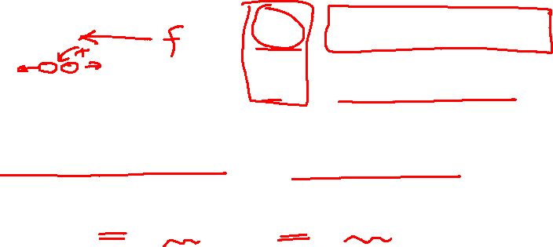
Designing a Linear Controller
physical system
control parameters

Slide 20

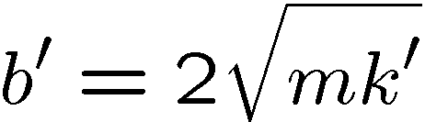
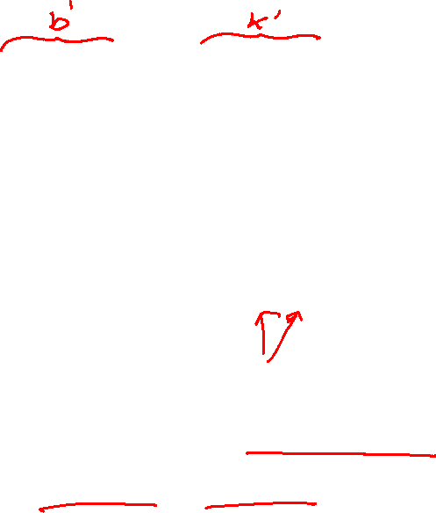
Linear Controller cont.
determines damping
closed-loop stiffness
for critical damping:
Example:

Slide 21
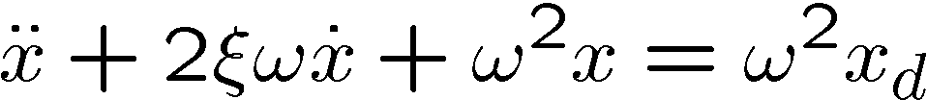
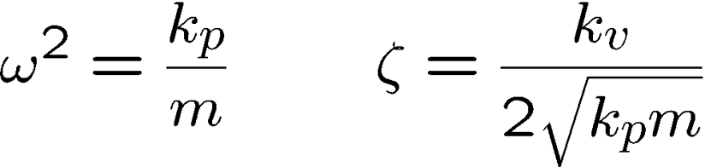
Proportional Derivative (PD) Control
Propotional to reduce error
Derivative (velocity) to introduce dissipation
closed-loop frequency
closed-loop damping ratio
Notes:
We now scale by the mass! This is important! What does this mean for a manipulator with many degrees of freedom?

Slide 22


Notes:
Background image
https://www.pexels.com/photo/background-black-blackboard-board-159770/

